Slide 1
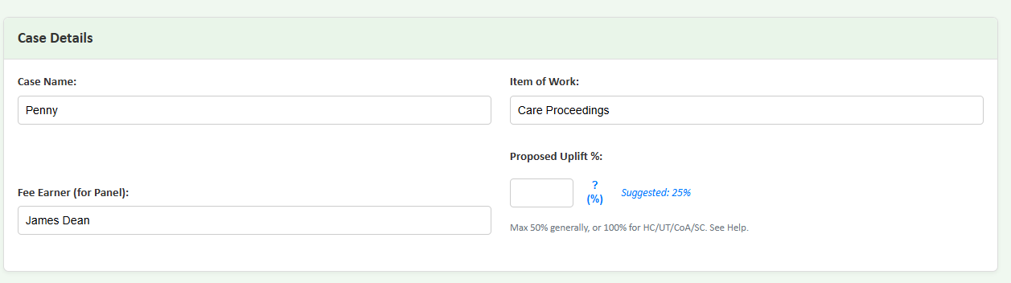
Fee Earner: Case / Matter:
Matter Type: Proposed Uplift %:
Select Case Type ...
Suggested: %

Slide 2



Woodruff Billing
General Enhancements - Uplift Justification Collator
Uplift Justification Collator
Fee Earner:
Case / Matter:
Filing of Evidence
Welcome
LAA Uplifts
Thresholds
Chloe Justice
Smith 29964
View LAA Guide (pdf) Clear Page Entries
Help about: Matter Type
Matter Type:
Select Case Type ...
Help about: Matter Type
Continue
This form is for the use of Woodruff Billing clients only. Please refer to our terms & conditions. (c)Woodruff Billing Ltd 2025

Slide 3
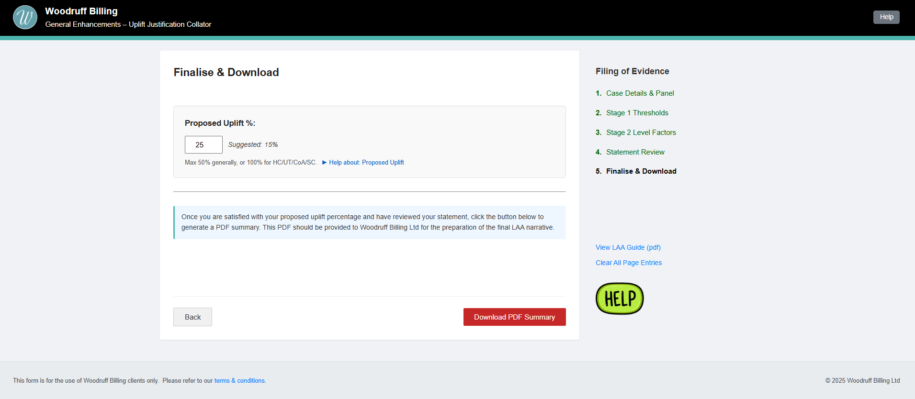




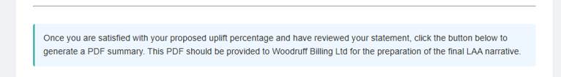




Slide 4


